Slide 1


The AquaDucks
UH-Fluor Construction-Driven Execution Design Challenge:
PUMP IT UP!
Joseph Amar
Zach McBurney
Saul Pizano
October 31, 2019

Slide 2
This area should be a picture of the three of us
Joseph Amar
Zach McBurney
Saul Pizano
Design Lead
Programmer (at least he tries)
Innovation
Quality Assurance Lead
Risk Management
Innovation
Presentation Chief
Quality Assurance
Ensures solutions are comprehensible
Time Management was easy: we spent every free minute on this project!
Notes:
The name AquaDucks is a play on the Roman aqueducts. It actually seems to be the more prevalent pronunciation, so we figured, why not make our name something people already say when they refer to transporting water over long distances?

Slide 3
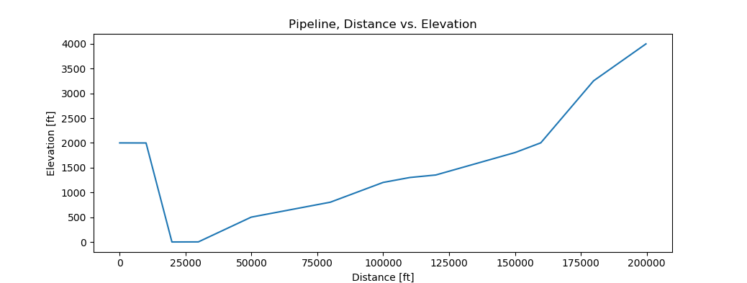
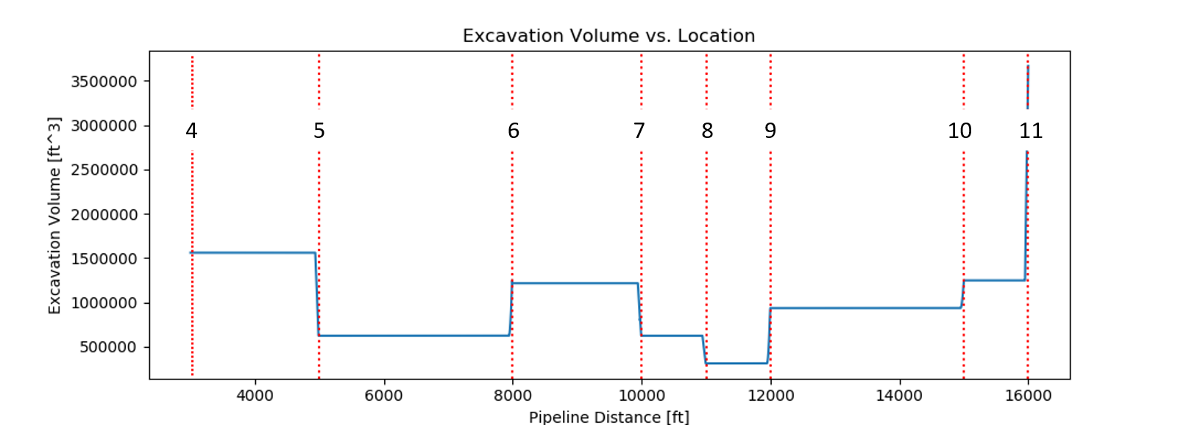
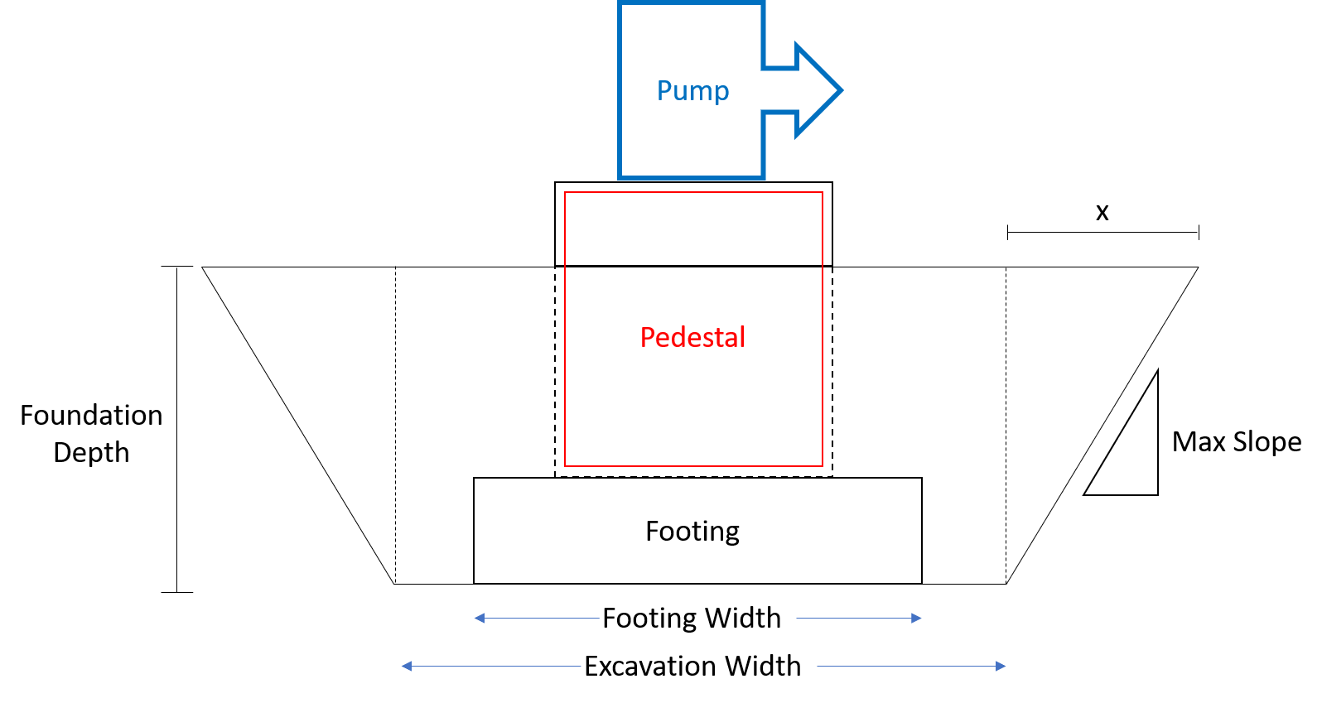
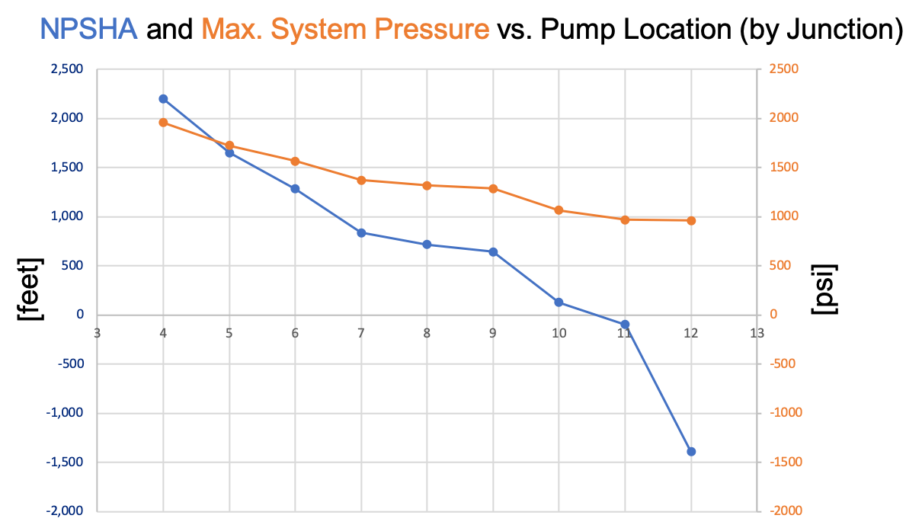
The Initial Solution
Notes:
We wanted to spend the majority of our time on the initial solution. This portion of the project had many variables, but they were still finite, which led us to believe that there may be a single correct solution. Reaching this singular solution became the main goal, because we knew it would make the ZBE much easier.
For the hydraulics portion, we used a method in combinatorics known as “n choose k,” which allows you to build all combinations of a certain size from a given set. This way, we were able to iteratively test every possible combination of 3 pipe thicknesses, with the program then rank-ordering them in order of cost. This automatically took care of the civil design aspect as well, because the pipe thicknesses were tested based on the Fathom software’s results for pump placement at every possible junction.
Calculating equipment was then simply a matter of attempting to spread out the work over the available time period without creating significant overages. Trying to get 350 track hoes to complete the excavation in a single day isn’t feasible; it’s much better to give the crews room to maneuver to make them optimally efficient.

Slide 4
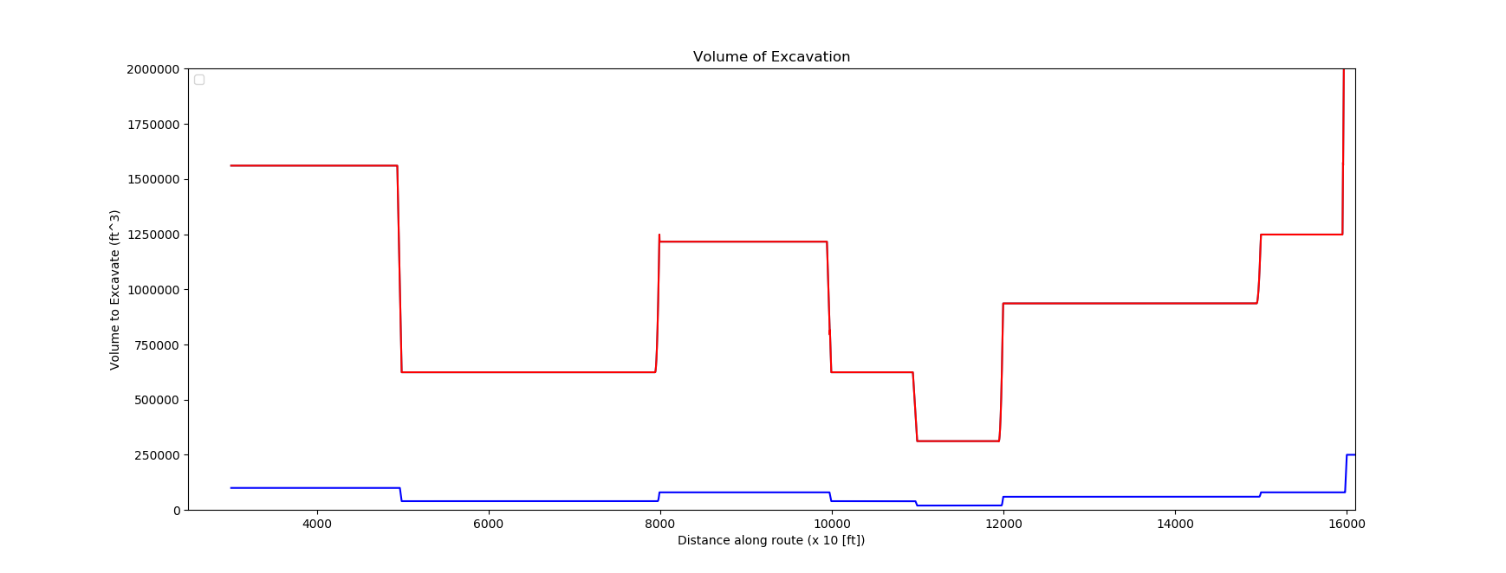
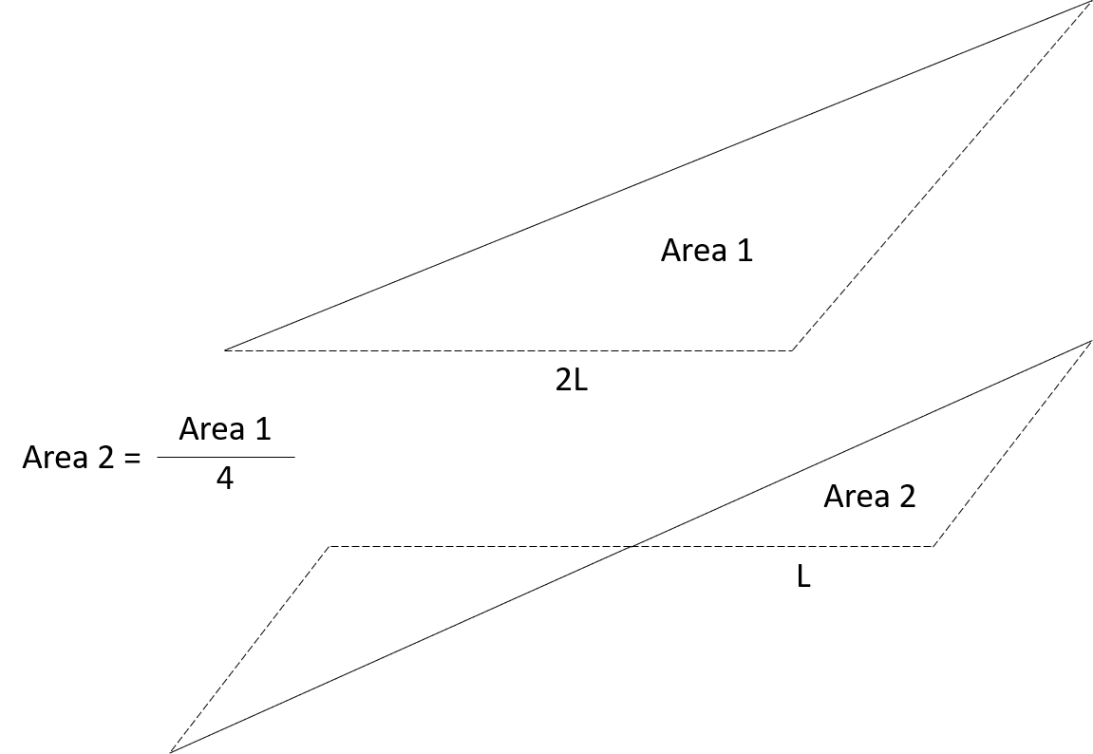
Zero-Based Execution
A₁V₁
=
A₂V₂

Slide 5
Modularization
Modularization seems to reduce costs at the expense of increased risks
Modularized components can be built/repaired more easily in-field
This in-field maintenance introduces the risks of foreign object damage in sensitive areas
This risk is compounded in very sandy areas, such as the project location
Key Takeaway: risk/reward must be quantified before making a final decision on the benefits of modularization—not enough info on risk!

Slide 6
 | Solution | Cost
Hydraulics & Civil Design | .25”, .312”, and .5” schedules Pump E Junction 10 pump location | $69,476,812
Equipment | 350 track-hoe-days 1160 dump-truck-days 1 crane-day 5 concrete-truck-days | $3,035,000
Total |  | $72,511,812
Cost Summary
A savings of $39,169,568 compared to initial design
 | Solution | Cost
Hydraulics & Civil Design | .25”, .375”, and .5” schedules Pump F x 2 Junctions 9 and 11 pump locations | $33,166,245
Equipment | 12 track-hoe-days 6 dump-truck-days 1 crane-day 4 concrete-truck-days | $176,000
Total |  | $33,342,244
Initial Solution
ZBE

Slide 7
Risk Assessment
Combination of pipe thickness
Pump placement
Pump site leveling
Time
Calculation of work truck quantity
Notes:
The most important risk that has a major tie in on total cost is the combination of pipe thicknesses. Specifically the exact location in which the pipe thicknesses change. If incorrect calculations are used to determine thickness change points, the overall cost of the project can fluctuate by millions of dollars. To mitigate this risk we have implemented an N choose K combinatorial function into our code.
Following pipe thickenss in level of importance in regards to risk is the selected pump placement

Slide 8
Proposed Innovation Concept
One large pump creates a large pressure increase
This corresponds to a requirement for thicker walls
Minimum required pressure at outlet
Gauge Pressure
Pump Location
Distance
Several pumps reduce these pressure spikes
Can this be improved? Theoretically, yes
A system composed of infinitesimally small pumps would motivate the fluid while avoiding pressure spikes
Notes:
If an additional pump can be added to the system for less cost than the marginal savings caused by the system’s pressure drop, it should be added.

Slide 9
Backup Slides

Slide 10
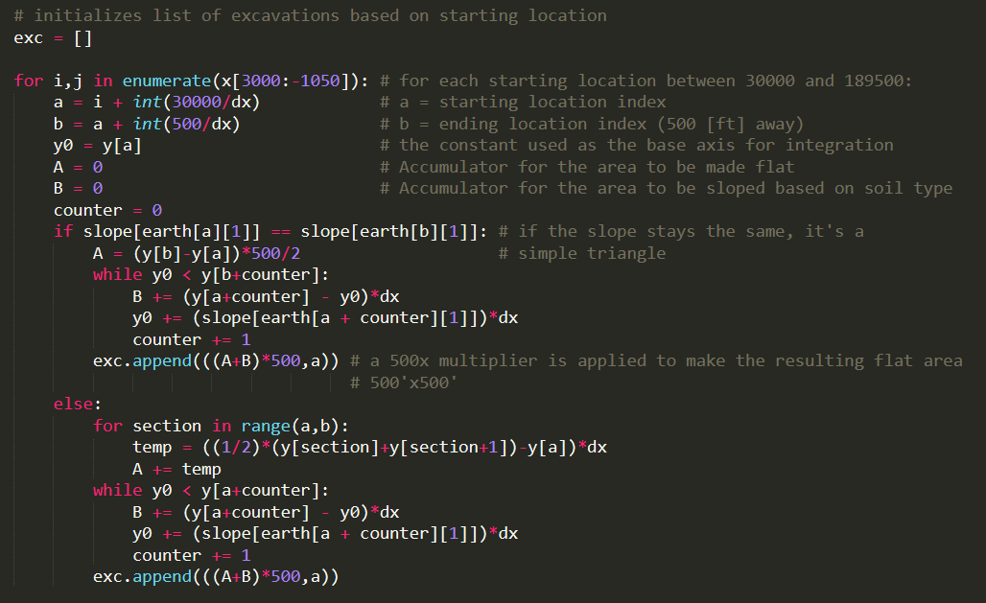
Excavation Volumes

Slide 11
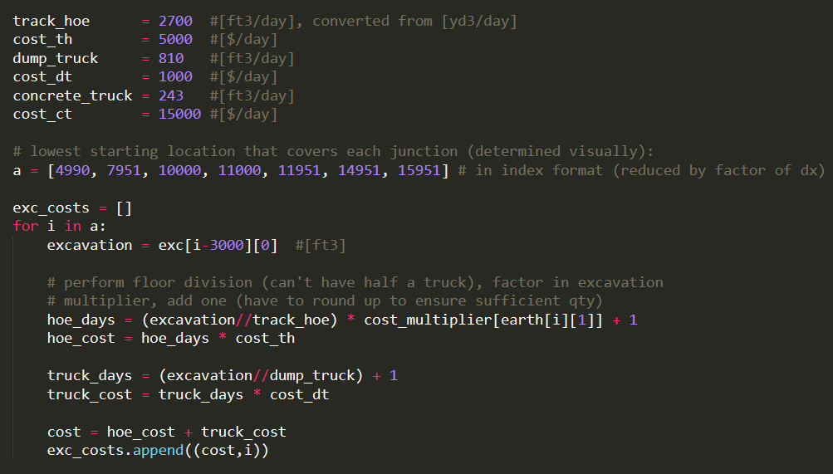
Equipment Costs

Slide 12
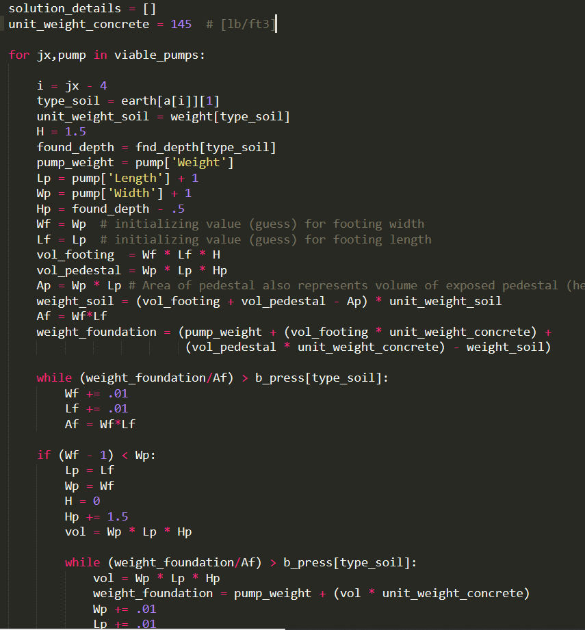
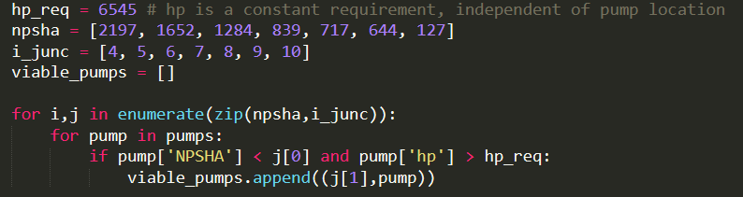
Foundation Calculations
Pump viability checker

Slide 13
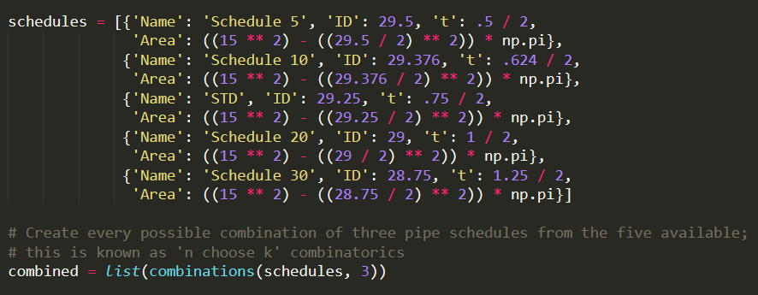
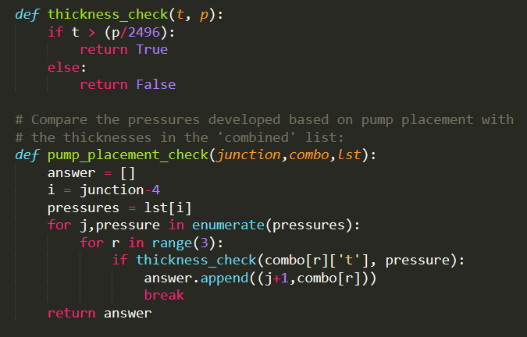
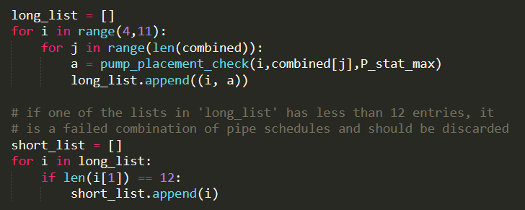
Pipe Thickness Calculations

Slide 14
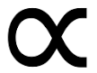
Maximum Pressure
Wall thickness
Material Volume
Cost of Pipes
Pumps
Pipes
Total System
Cost [$]
Number of Pumps
Notes:
This gives a more favorable tradeoff leading to a cheaper total cost

Slide 15
Time Management
(Sub)Steps to Complete | Time Taken (man-hours)
1) Game Plan—responsibilities shouldn’t encroach on each other, but should allow for collaboration | 4.5
2) Two-dimensional plotting | .5
3) Excavation derivation | 3
4) AFT Fathom familiarization | 2
5) Foundation derivation | 4
6) Initial code—pipeline plot, excavation volumes | 3
7) AFT Fathom simulation, junctions 4 - 12 | 1.5
(Sub)Steps to Complete | Time Taken (man-hours)
8) Appending code with maximum pressures for each pipe section based on pump location | 1
9) Iterative foundation calculations | 3.5
10) Pipeline pressure checks (and code) | 6
11) Final Calculations/verifications | 10
12) ZBE Adaptation/Risks/Modularization | 12
13) Innovation concept—brainstorm and discussion | 3
14) Narrative drafts and finalization | 9
Total: 63 hours

Slide 16
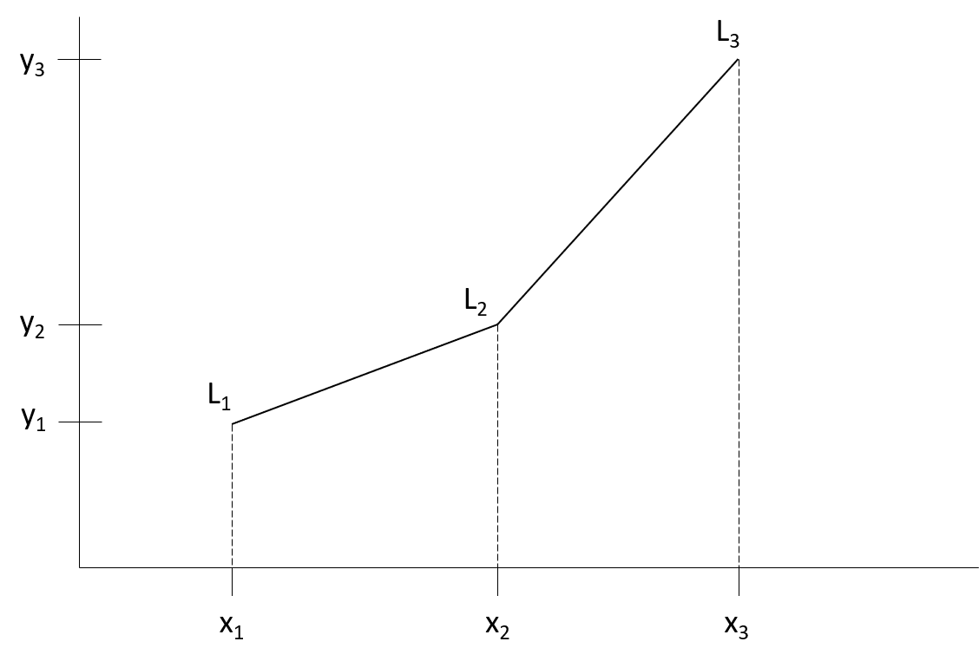
Calculations

Slide 17
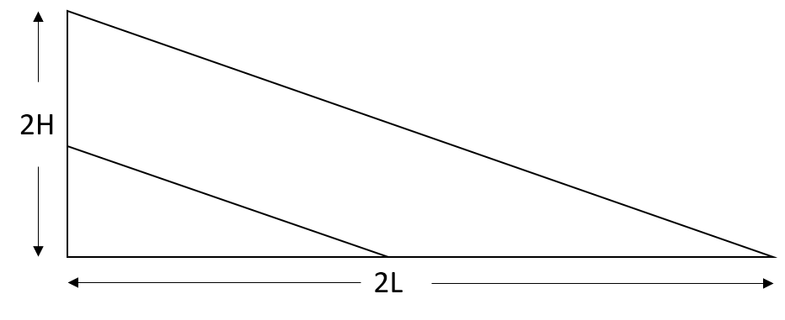
Zero-Based Execution

Slide 18
Constructability

Slide 19
Since none of us knew anything about pipelines prior to this project, we knew we would need some type of iterative method to test solutions
Iteration requires subgroups – created groups in order of priority:
Constancy – what things will not change between designs?
Group Size – which groups are smallest? Start with those.
Ease of solution – by completing the easiest pieces first, we can minimize the number of places at which to evaluate the difficult components

